Slide 1

Computer Networks And Security
19CS2109
The Network Layer in the Internet
© 2020-21 KL University – The contents of this presentation are an intellectual and copyrighted property of KL University. ALL RIGHTS RESERVED
1

Slide 2

The Network Layer in the Internet
•The IP Protocol
•IP Addresses
•Internet Control Protocols
•OSPF – The Interior Gateway Routing Protocol
•BGP – The Exterior Gateway Routing Protocol
•Internet Multicasting
•IPv6

Slide 3
Design Principles for Internet
1.Make sure it works.
2.Keep it simple.
3.Make clear choices.
4.Exploit modularity.
5.Expect heterogeneity.
6.Avoid static options and parameters.
7.Look for a good design; it need not be perfect.
8.Be strict when sending and tolerant when receiving.
9.Think about scalability.
10.Consider performance and cost.

Slide 4
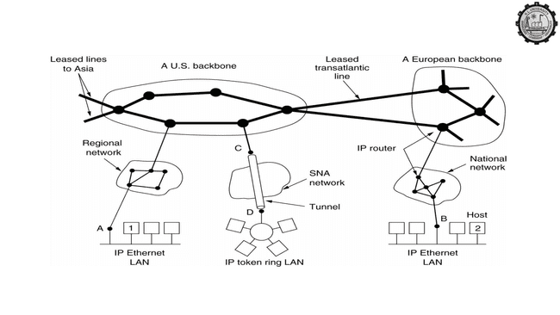
Collection of Subnetworks
The Internet is an interconnected collection of many networks.

Slide 5
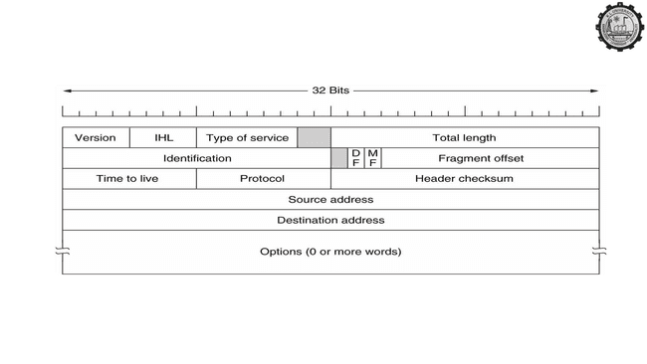
The IP Protocol
The IPv4 (Internet Protocol) header.

Slide 6
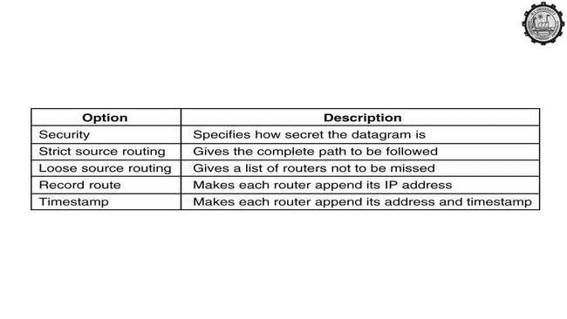
The IP Protocol (2)
Some of the IP options.

Slide 7
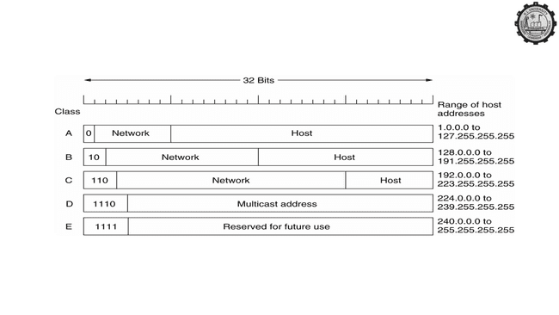
IP Addresses
IP address formats.

Slide 8
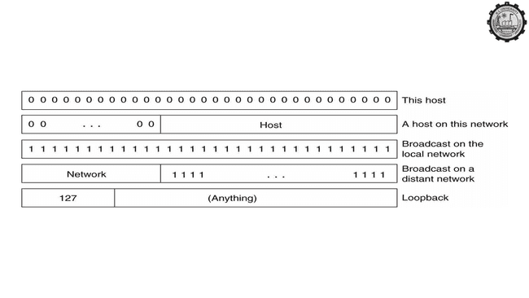
IP Addresses (2)
Special IP addresses.

Slide 9
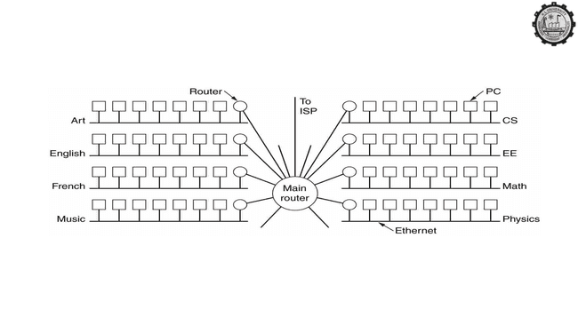
Subnets
A campus network consisting of LANs for various departments.

Slide 10
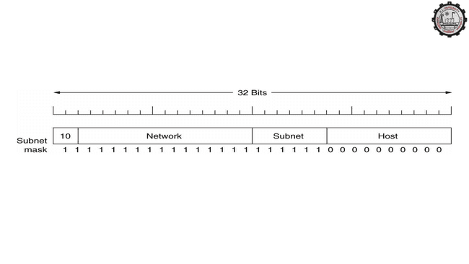
Subnets (2)
A class B network subnetted into 64 subnets.

Slide 11
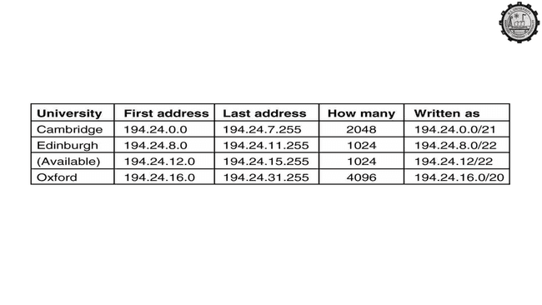
CDR – Classless InterDomain Routing
A set of IP address assignments.

Slide 12
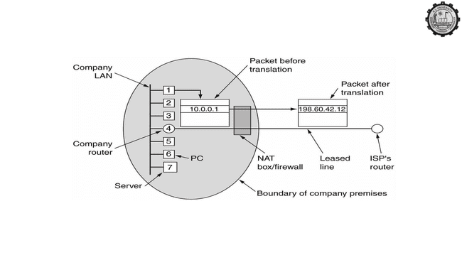
NAT – Network Address Translation
Placement and operation of a NAT box.

Slide 13
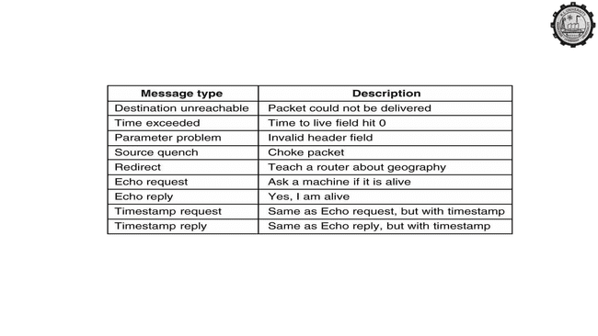
Internet Control Message Protocol
The principal ICMP message types.

Slide 14
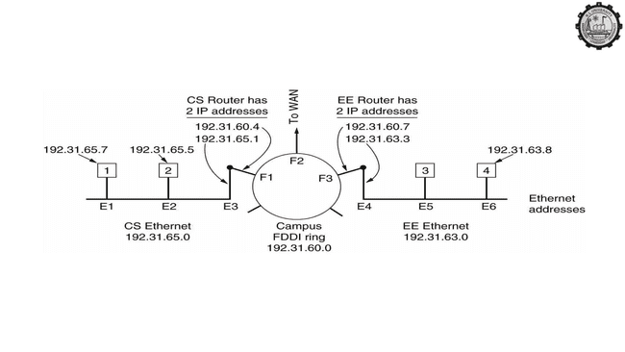
ARP– The Address Resolution Protocol
Three interconnected /24 networks: two Ethernets and an FDDI ring.

Slide 15
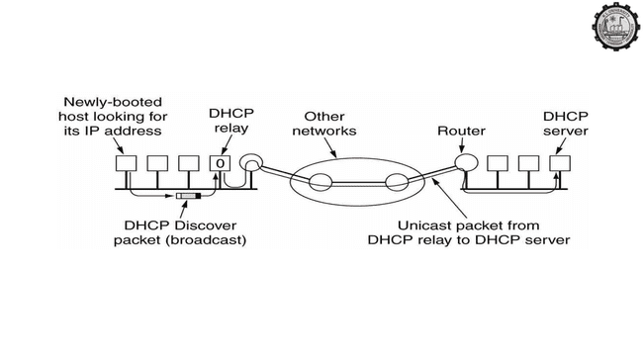
Dynamic Host Configuration Protocol
Operation of DHCP.

Slide 16
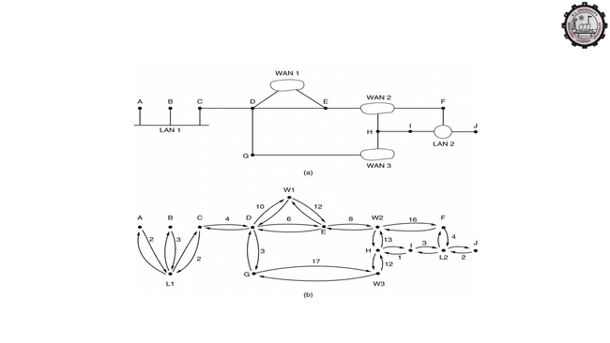
OSPF – The Interior Gateway Routing Protocol
(a) An autonomous system. (b) A graph representation of (a).

Slide 17
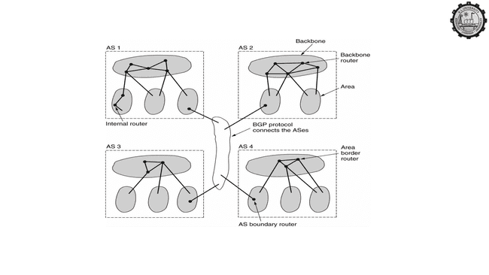
OSPF (2)
The relation between ASes, backbones, and areas in OSPF.

Slide 18
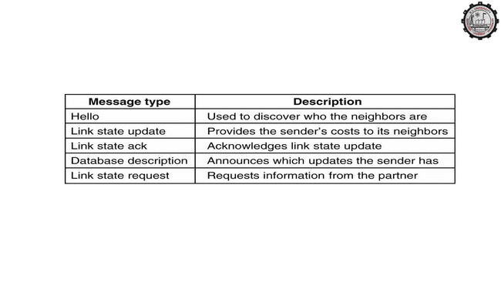
OSPF (3)
The five types of OSPF messeges.

Slide 19
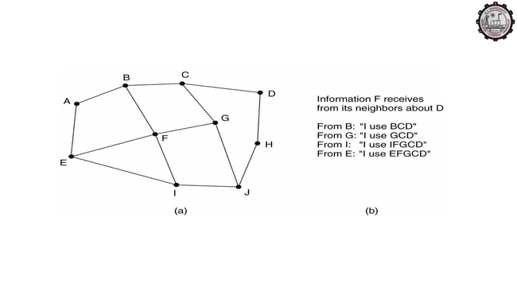
BGP – The Exterior Gateway Routing Protocol
(a) A set of BGP routers. (b) Information sent to F.

Slide 20
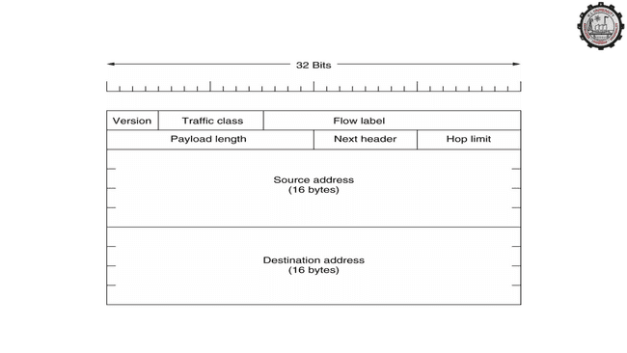
The Main IPv6 Header
The IPv6 fixed header (required).

Slide 21
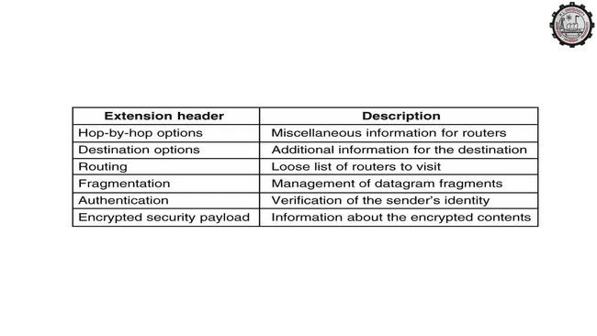
Extension Headers
IPv6 extension headers.

Slide 22
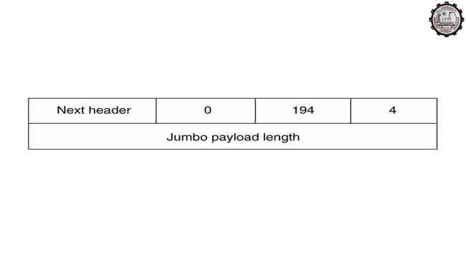
Extension Headers (2)
The hop-by-hop extension header for large datagrams (jumbograms).

Slide 23
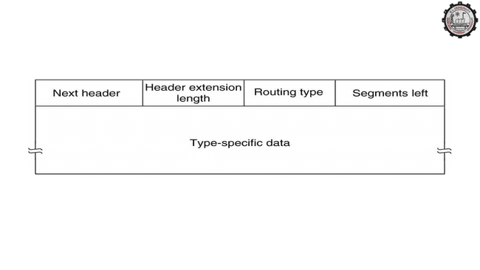
Extension Headers (3)
The extension header for routing.

